Slide 1

ENSE 477 BI-WEEKLY SCRUM REPORT-OUT
CALTOR
EARL JEDRICK MACALINO
UMANGI PATEL
GLAIZA REGONAS
[28th January, 2020]

Slide 2

PROJECT DEATS
Remind me what you are doing
What problem(s) are you trying to solve?
To upgrade the Grading Calculator and academic Planner for the Academic Transition Program in UofR.
What gap are you filling?
To have a proper and reliable web application that will help students get out of probation.
What innovation are you creating?
A web page that will act as a tool to help students keep track of their grades.

Slide 3
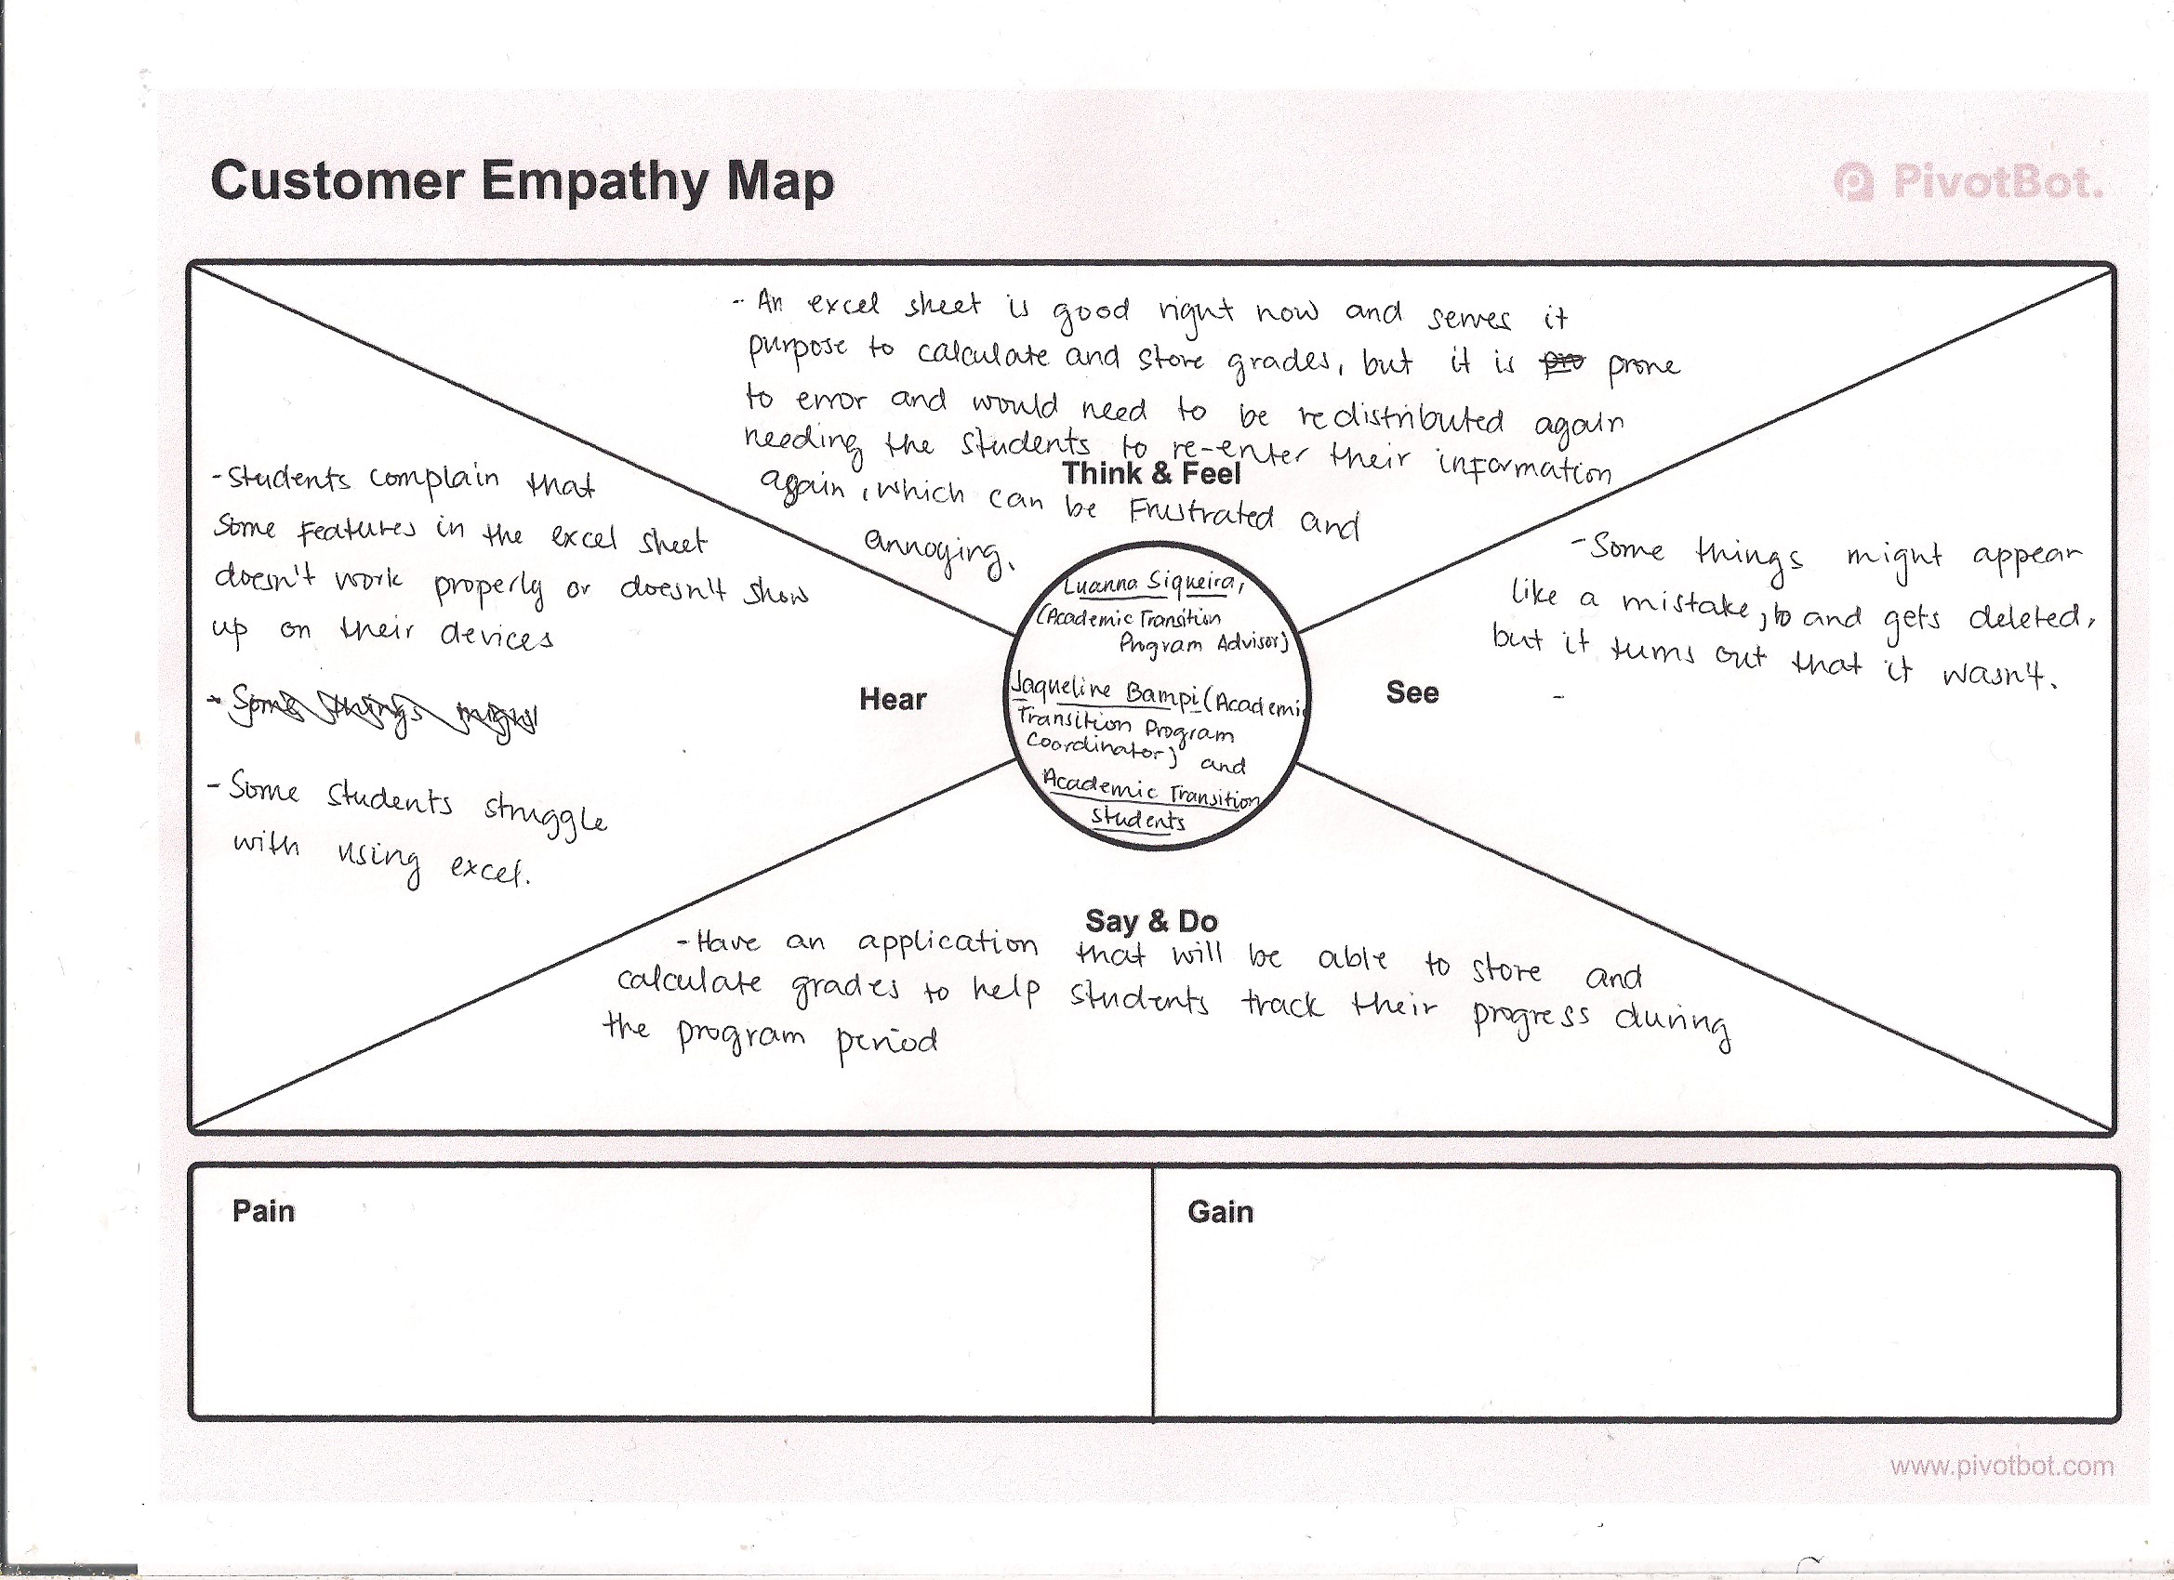
Vision, Rationale, Stakeholders (Empathy Map)

Slide 4
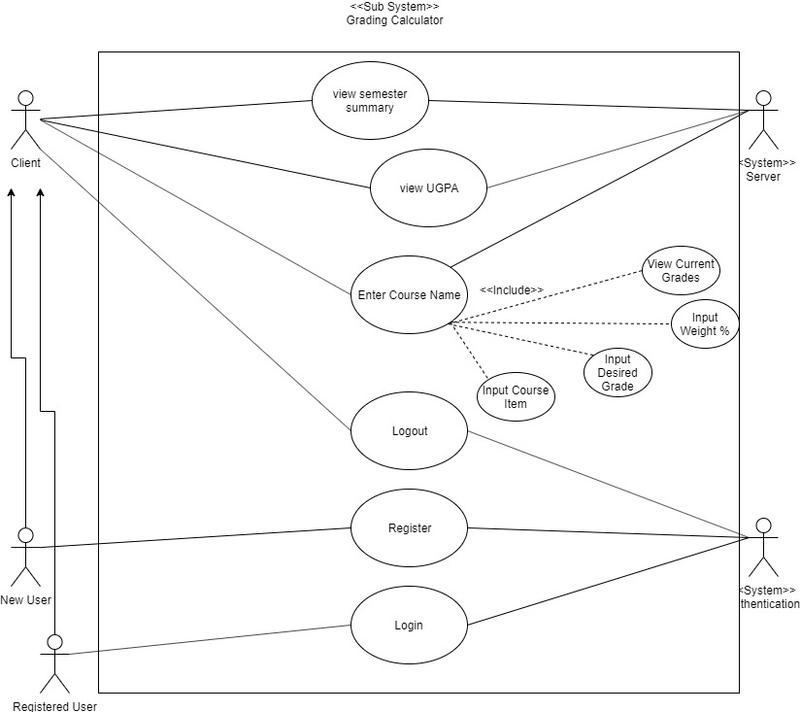
Use Case Diagram

Slide 5
Constraints and Function Requirements
Functional requirements
The Grading Calculator must be able to:
Have user signup and log in
Stores user’s inputs (assignment grades, grades from previous classes)
From those stored data be able to calculate the user’s UGPA according the University of Regina standard
Have those data and calculations saved when the user logs back in so that they don’t have to keep entering their grades
Have a different section for the Academic Transition Program class
Be able to also be used by other students not just the ones in the program
An academic plan that will help student plan out their future classes.
Constraints
Users will need to enter their previous grades in order to determine their UGPA and store it in the database.
Not free to design what we want; we must constantly meet with the stakeholders for them to approve every step with make.

Slide 6
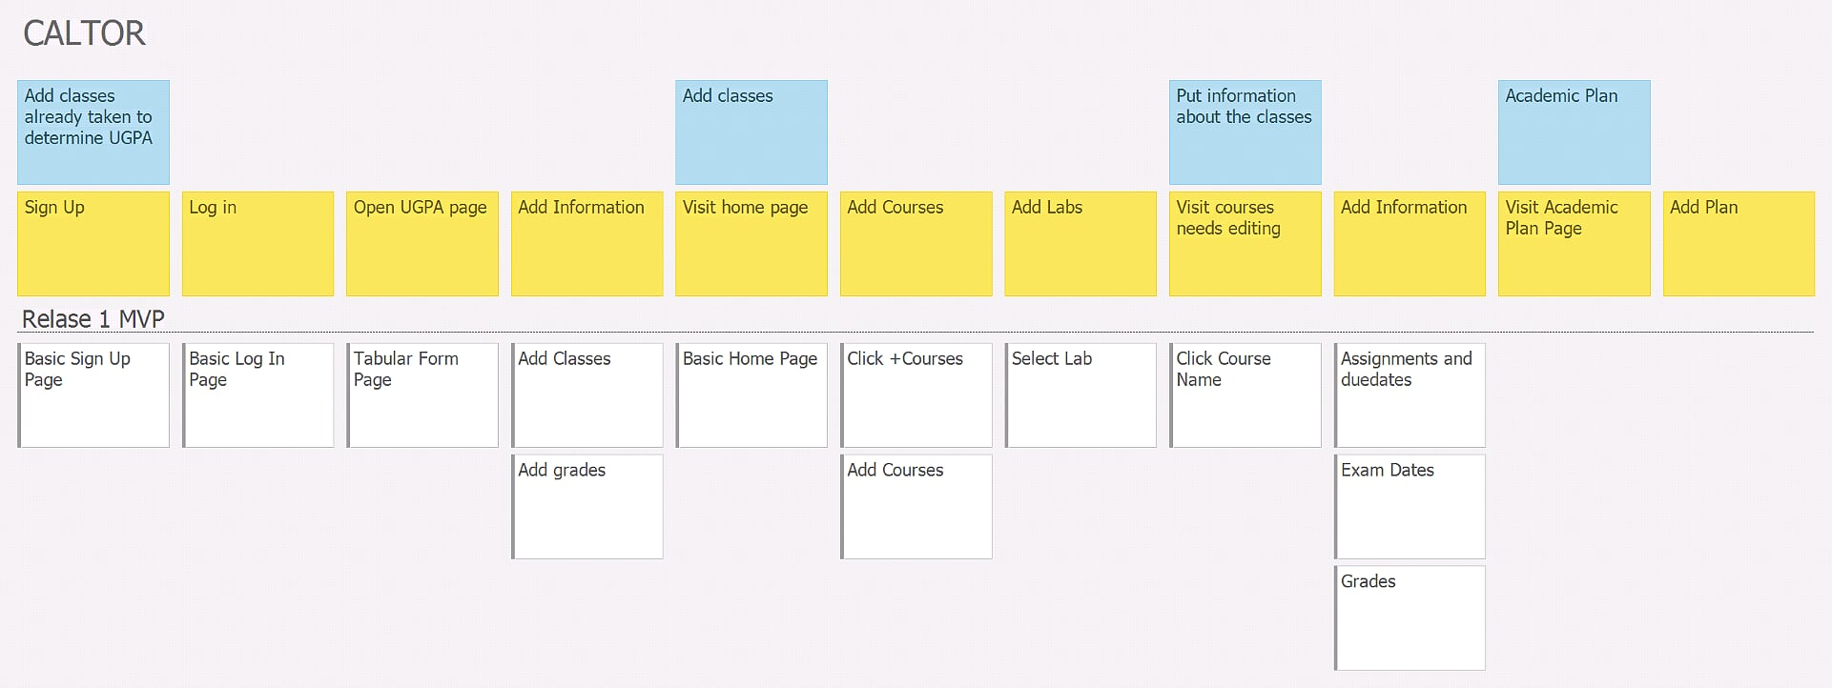
StoriesOnBoard

Slide 7
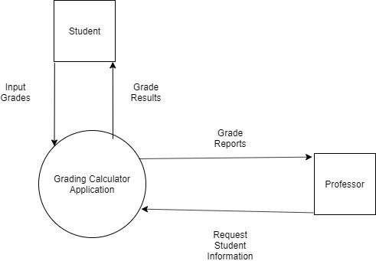
Context Diagram

Slide 8
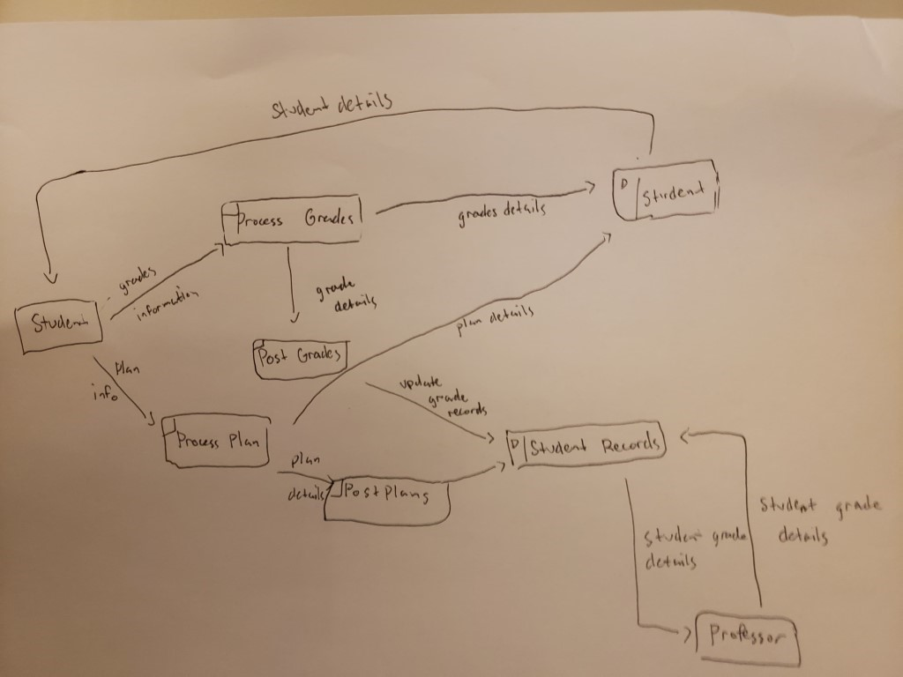
Dataflow Diagram

Slide 9
PROJECT & DOCUMENTATION REVIEW
Program Language used: HTML, CSS, React JS, Ajax, Jquery, JSON
Testing plans/work
Functionality testing
Usability testing: In Progress
Interface Testing: In Progress
Compatibility Testing: In Progress
Performance Testing
Security Testing
Deployment/change management plan/work
Maintenance & refactoring plan/work
No maintenance needed once done the project.

Slide 10
Demo

Slide 11

GitHub/Version control “stamp of approval”
GitHub:
ttps://github.com/regonasg/Capstone-Project

Slide 12
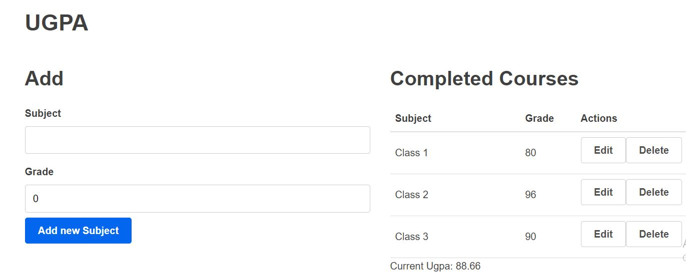

Slide 13

GROUP REFLECTION
Do you feel you are on track?
No we are not
Do you feel there are barriers to your success (if any)?
None right now
Do you need any help going forward?
Not right now
Any other questions or concerns?
No

Slide 14
IMAGE REFS
Show me what you got, https://pictures.abebooks.com/isbn/9781548899530-us-300.jpg
Patrick, https://imgflip.com/memetemplate/43274976/spongebob-patrick-nail-saw
Dilbert, http://4.bp.blogspot.com/-tVbJsudDNaw/T29WxQ0PHZI/AAAAAAAAABc/UlTwD2gkzA4/s1600/Dilbert%2520Software%2520Demo%5B1%5D.jpg
Pondering, https://imgflip.com/s/meme/Question-Rage-Face.jpg
Seal of Approval, https://www.instructables.com/id/How-to-Make-a-Quality-Meme/
Empathy Map Template, https://medium.com/pivotbot/the-customer-empathy-mapping-toolkit-1f7bc6ed8571

